Slide 1
1. Question
Clouds
Clouds are made up of many very small drops of water.
Have you ever seen clouds in the sky? Have you noticed that clouds are different shapes?
There are four major types of clouds. The type of cloud can help us predict the weather. Do you know which types of clouds bring snow? Which types of clouds bring rain?
Image Source: Subscription to clipart.com
How can clouds help us to predict the weather?

Slide 2
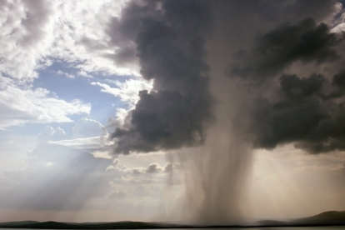
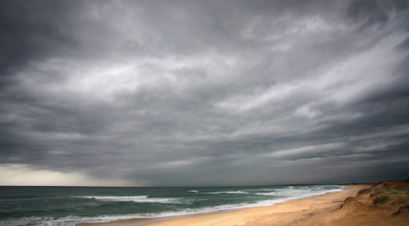
2. Information Sources
Types of Clouds
pebblego.com
What Are Clouds?
pebblego.com
Cumulus
Cirrus
Stratus
Nimbus
Image Source: Subscription to pebblego.com

Slide 3
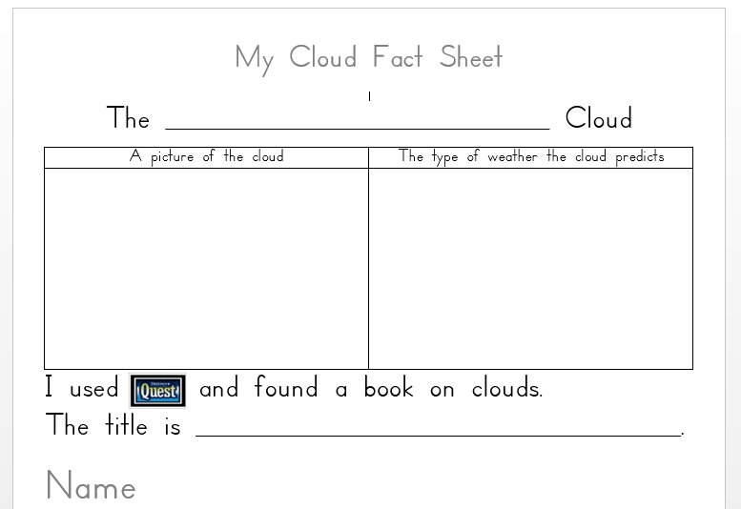
3. Student Activity
Pick a cloud you would like to recreate.
You will need to reread the information about your topic and take notes.
The note sheet will need a picture of the cloud and what type of weather it predicts.
You will also need to complete a visual search to locate books on clouds in our school library. You will navigate through the Destiny database.
clouds
Image Source: Subscription to Destiny.

Slide 4
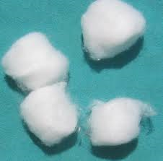
4. Assessment Activity
You will now create the cloud you have researched. You will use cotton balls to form the cloud.
Complete the sentence starter and attach it to your finished cloud replication.
Image Source: en.wikipedia.org

Slide 5
Review
Ask yourself…..
Did I find out more about my cloud?
Did I find out what weather comes from my cloud?
Did I follow directions to make my cloud?
Did I turn in my cloud organizer to my teacher?

Slide 6
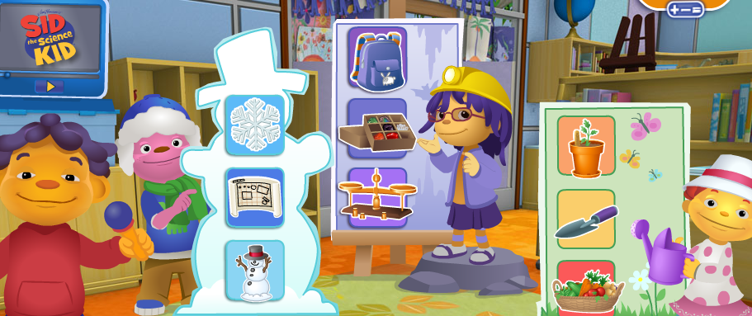
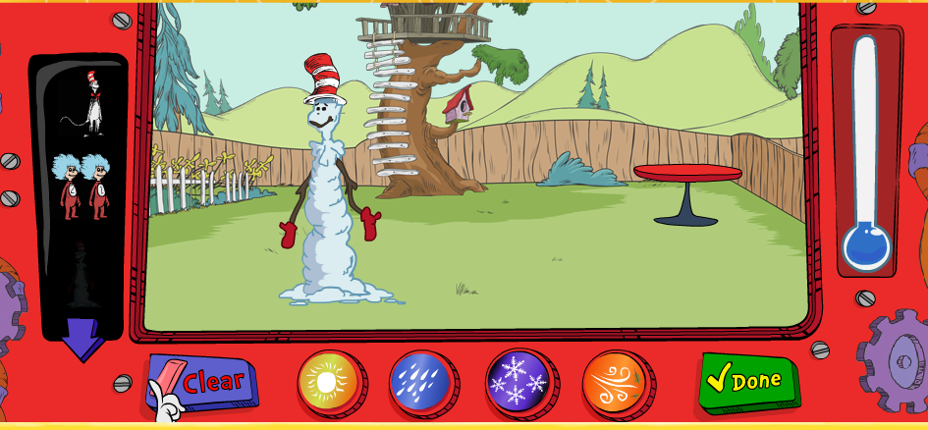
5. Enrichment Activities
Video on cloud formation
Super Lab Fun
Image Source: Subscription to Destiny
Image Source: pbskids.com
Tim and Moby share information on clouds
Magic School Bus- Kicks Up a Storm
Image Source:
Subscription to Brain Pop Jr.
Weather Transformer
Image Source: pbskids.com
Image Source: Subscription to Safari Montage

Slide 7
6. Teacher Support Materials
First grade and Library Media
Maryland State Curriculum 1.0 Skills and Processes. Students will demonstrate the thinking and acting inherent in the practice of science. A.1. Raise questions about the world around them and be willing to seek answers to some of them by making careful observations and trying things out. b. Seek information through reading, observation, exploration, and investigations. MCCRS Know and use various text features (e.g., headings, tables of contents, glossaries, electronic menus, icons) to locate key facts or information in a text. .Distinguish between information provided by pictures or other illustrations and information provided by the words in a text. Use the illustrations and details in a text to describe its key ideas. With prompting and support, read informational texts appropriately complex for grade 1. Standards for the 21st Century Learner 1.1.1 Follow an inquiry-based process in seeking knowledge in curricular subjects, and make the real-world connection for using this process in own life. 1.1.2 Use prior and background knowledge as context for new learning. 1.1.6 Read, view, and listen for information presented in any format (e.g. textual, visual, media, digital) in order to make inferences and gather meaning. 1.1.8 Demonstrate mastery of technology tools for accessing information and pursuing inquiry. 2.1.1 Continue an inquiry-based research process by applying critical-thinking skills (analysis, synthesis, evaluation, organization) to information and knowledge in order to construct new understandings, draw conclusions, and create new knowledge. 2.1.3 Use strategies to draw conclusions from information and apply knowledge to curricular areas, real-world situations, and further investigations. ISTE NETS - National Educational Technology Standards for Students 3. Research and information fluency. Students apply digital tools to gather, evaluate, and use information. d. Process data and report results
Maryland State Library Curriculum
2.0 Locate and Evaluate Resources and Sources: Students will be able to follow an inquiry process to identify, locate, evaluate, and select resources and sources in a wide variety of formats to meet the information need in an ethical manner. (AASL 21st 1)
3.0 Find, Generate, Record, and Organize Data/Information: Students will be able to follow an inquiry process to find, generate, record, and organize information relevant to the information need in an ethical manner. (AASL 21st 1)
4.0 Interpret Recorded Data/Information: Students will be able to follow an inquiry process to interpret recorded data/information to create new understandings and knowledge related to the information need in an ethical manner. (AASL 21st 2)
5.0 Share Findings/Conclusions: Students will be able to follow an inquiry process to share findings/conclusions in an appropriate format to support written, oral, and multimedia information products and evaluate the products and the processes in an ethical manner.
Time Frame: 3- 30 minute lessons
Differentiation strategies for this lesson: This slam dunk will need direct instruction in various points of the lesson. Students may need assistance in logging in to various websites. Some students may be able to complete the activities independently.
Learning Styles addressed in this lesson: Visual, Logical, Auditory, Tactile and Kinesthetic.
Notes to the teacher:
Slide 2- Students will need log in information for pebblego.com. Once at the sight they will need to search weather and then they will click on What are Clouds? The students will then need to view Types of Clouds. The students can then narrow down their search and reread/research the type of cloud they are interested in.
Slide 3- Students will need a paper copy of the Cloud Fact Sheet in order to record what they have leaned about their cloud. Assistance will be needed to search in Destiny for additional cloud books.
Slide 4- Blue construction paper, cotton balls and glue will be needed for students to complete their cloud replication. Students will need a paper copy of the sentence starter to complete.
If you do not subscribe to Brain Pop there are plenty of other resources listed.
Adapted with permission, BCPS

